Slide 1
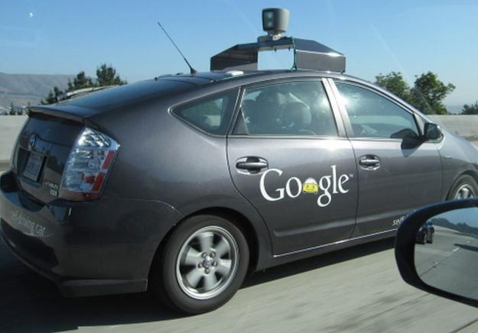
Optimization of Autonomous Traffic Flow at Intersections
Reduce wait time at intersections
Minimize congestion and gridlocking
Manage vehicle failures
Ensure driver safety

